Slide 1


WEATHERSHARE
Share the weather around you
Satria Utama
github.com/satria-mitra/weathershare

Slide 2
Current Issues
Most weather forecast is accurate, but the real condition might be differ on the ground
Many weather stations stand alone without combining their data with one another
There is no solid platform to integrate chain of weather stations

Slide 3
Benefits
Crowdsourcing can significantly increase the number of data points available for weather prediction
Crowdsourced data can offer real-time information on weather conditions, making it possible to track changes more quickly than with standard meteorological services.

Slide 4
Mock up Design (before)….
Welcome Page
Home
Maps
Publish a report
Crowsourced reports
Account

Slide 5
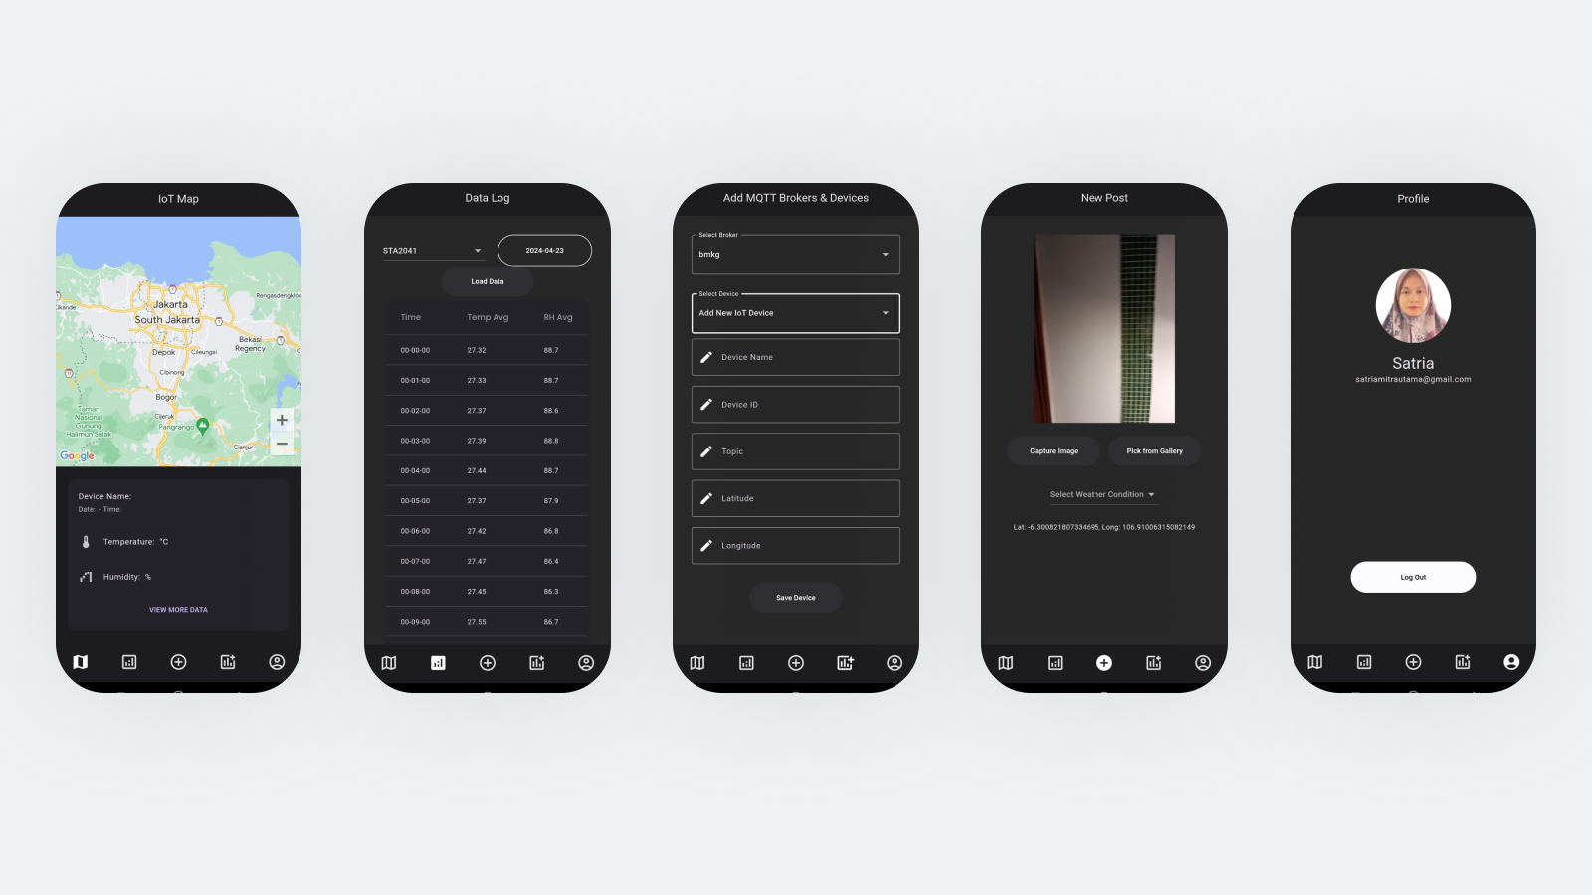
Final Results

Slide 6
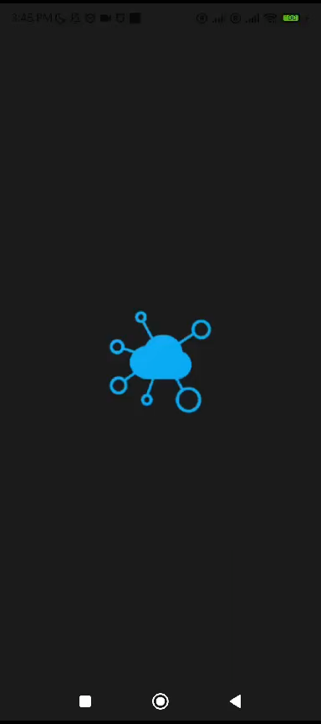
Demonstration video

Slide 7
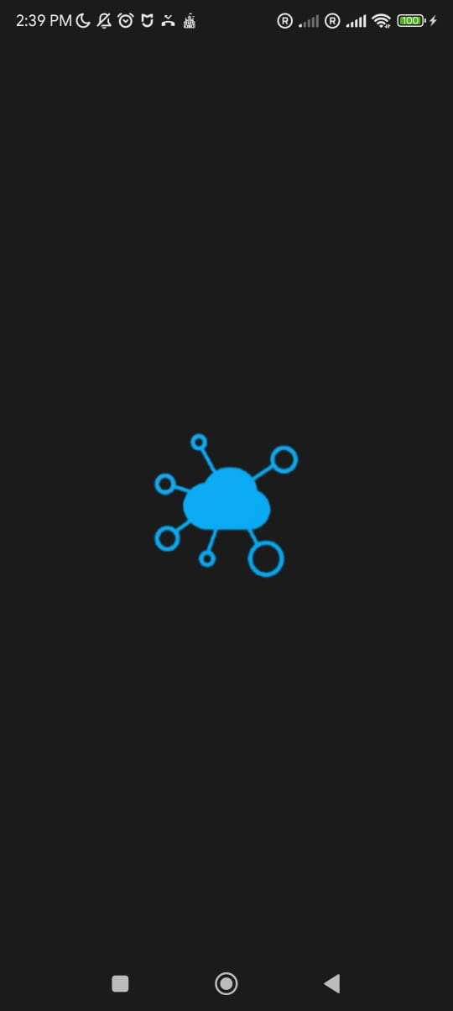
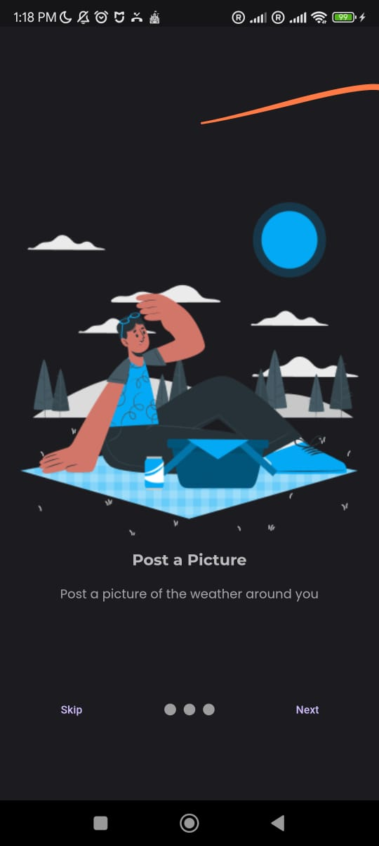
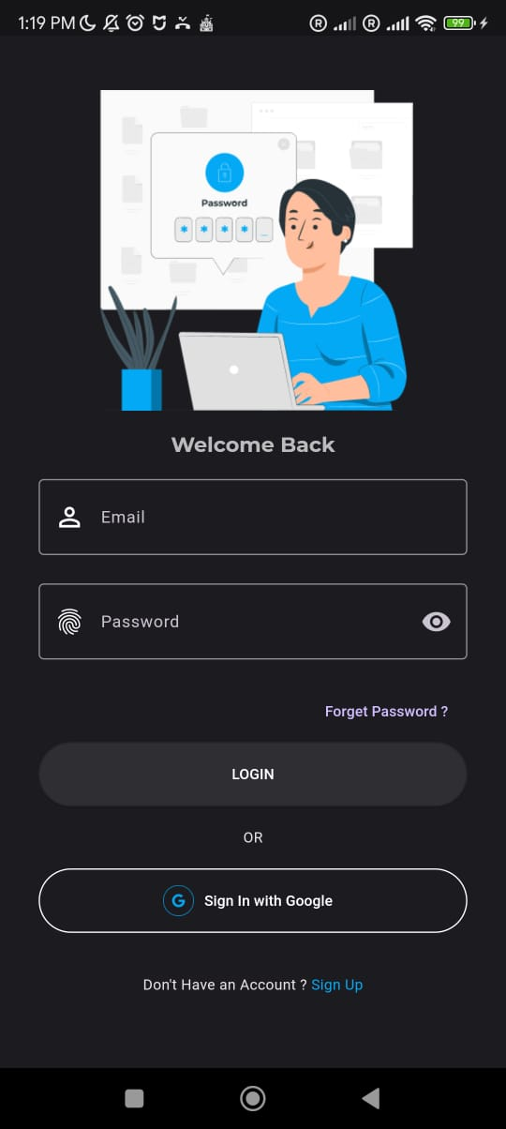
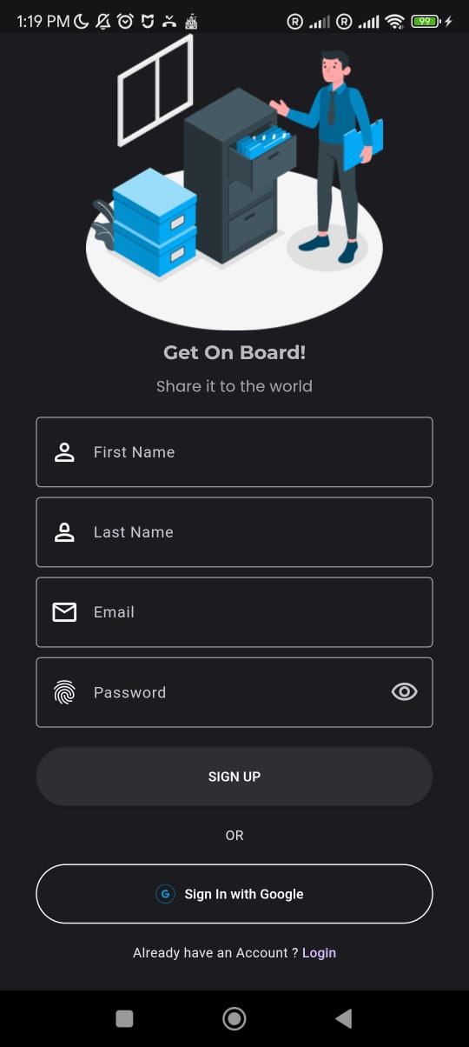
Other screens
Splash Screen
Onboarding Screen
Google sign in
Signup screen

Slide 8
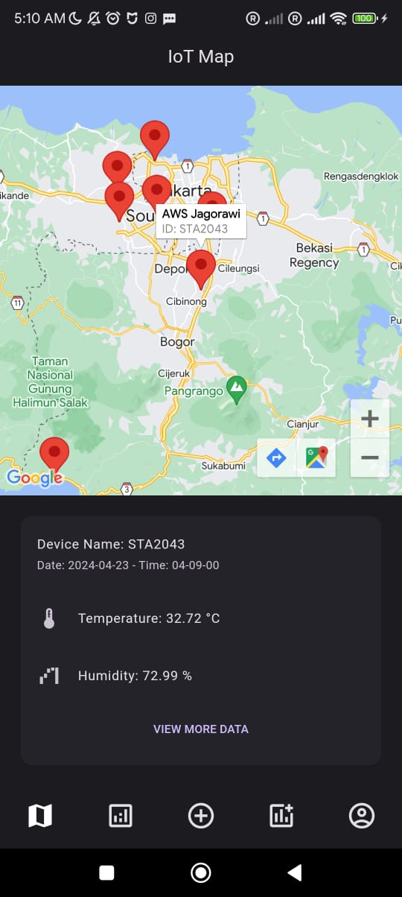
Map screen
Google maps with marker of Weather Station of Meteorology Agency of Indonesia (BMKG)
Card as a frame to display current temperature and humidity
Data source from BMKG MQTT broker
Bottom Navigation Bar

Slide 9
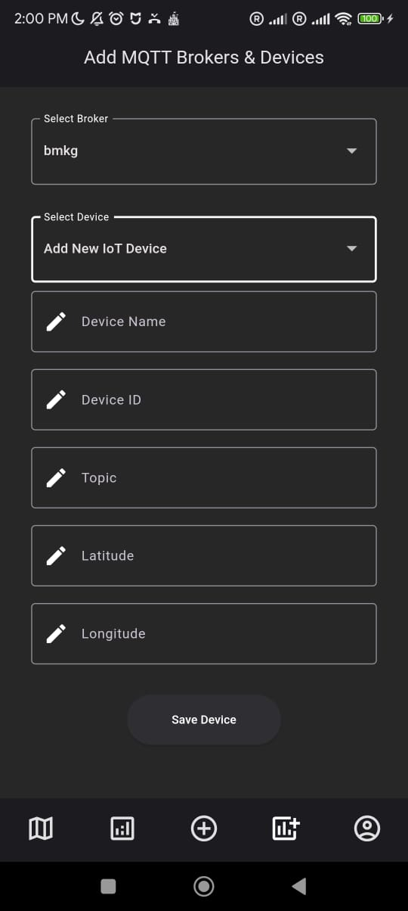
Page to add MQTT brokers and IoT Devices
Google functions as a backend service to sub BMKG broker
Save device metadata to Firestore Database
Input field : - Device Name
Device ID
Topic
Latt & Long

Slide 10
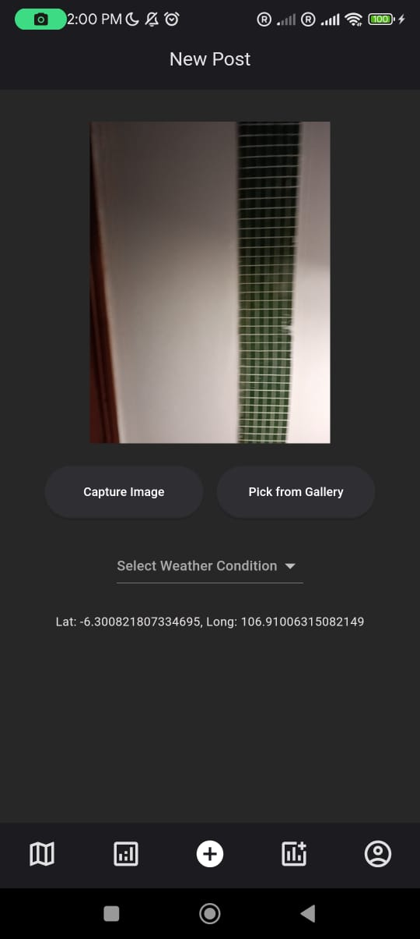
Post a picture
Take a picture from camera or choose from Gallery
Choose weather type from a dropdown menu [Rainy, Cloudy, Sunny, Windy, Stormy]
Get current location from GPS
Save these details to Firestore Database

Slide 11
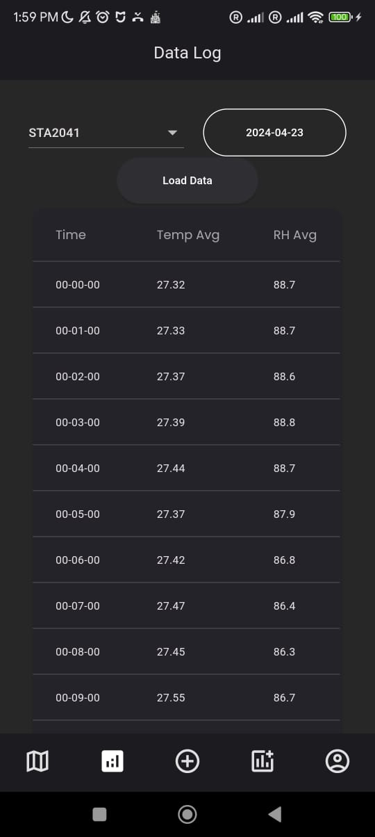
Data Log
Filter Devices and Date
Show the data and timestamp to Paginated Data Table

Slide 12
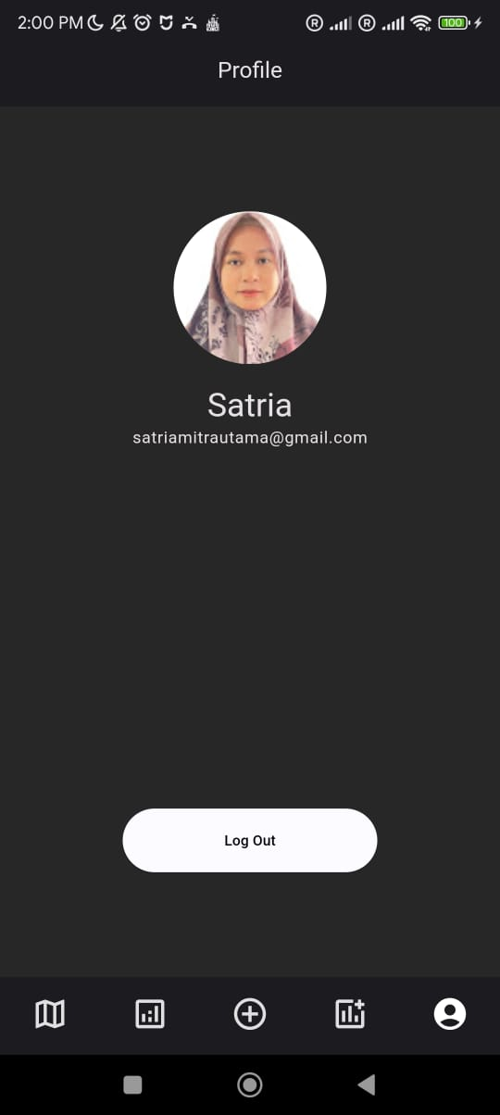
Account
Display the user information (only name and email at the moment)
Logout button

Slide 13
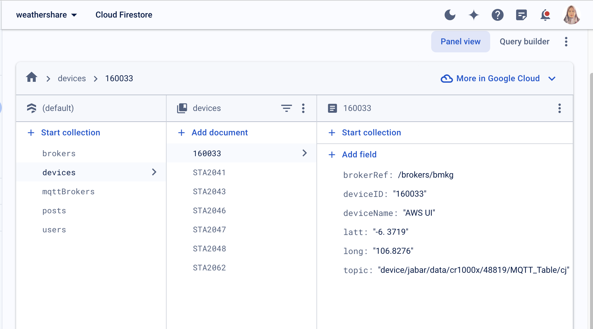
Data Source
MQTT Weather Station
Photo & user input

Slide 14
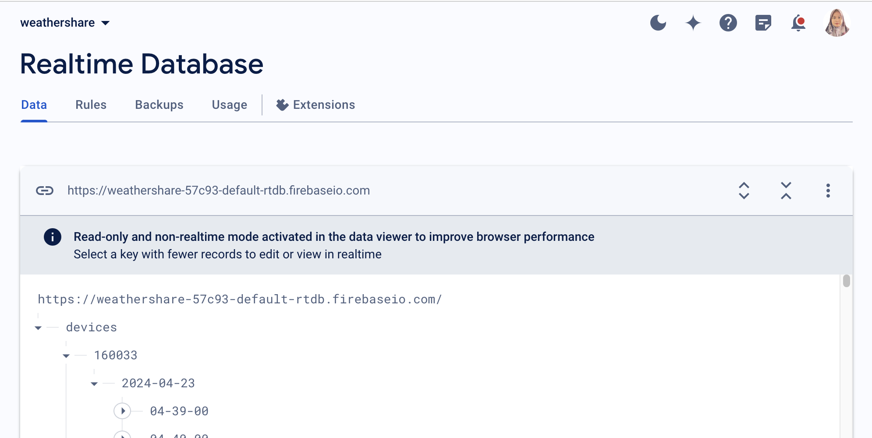
Database
Firestore Database to store static data (users, device metadata etc)
Firebase Realtime Database to store dynamic data (data from MQTT)

Slide 15
Firestore Database
Firestore Database | |--- brokers (Collection) | |--- Document (ID : mqttName)(String) |-- host (String) |-- mqttname: (String) |-- password: (String) |-- port: (String) |-- username: (String)
Firestore Database | |--- devices (Collection) | |--- Document (ID : deviceID) (String) |-- brokerRef : /brokers/$.deviceID (reference)
|-- deviceID : (string)
|-- deviceName (string)
|-- latt (string)
|-- long (string)
|-- topic(string)
Firestore Database | |--- users (Collection) | |--- Document (ID : random) (String) |-- Email : /brokers/$.deviceID (reference)
|-- Firstname : (string)
|-- Lastname (string)

Slide 16
Realtime Database
Realtime Database | |--- devices (Collection) | |--- Document (ID : deviceID)(String) |-- date (String) |-- time: (String) |-- rh_avg: (String) |-- temp_avg: (String)

Slide 17
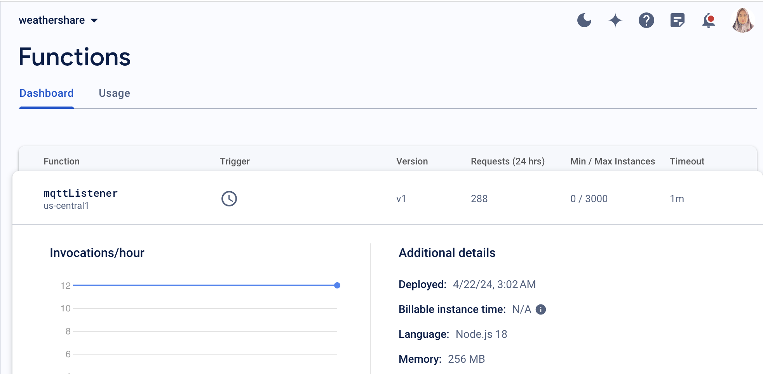
Google Functions
Backend services to auto pub sub MQTT Brokers

Slide 18
Dependencies
camera: ^0.10.5+9
change_app_package_name: ^1.1.0
cloud_firestore: ^4.16.1
firebase_auth: ^4.19.1
firebase_core: ^2.29.0
firebase_database: ^10.5.2
firebase_storage: ^11.7.1
firebase_ui_auth: ^1.13.1
flutter_native_splash: ^2.4.0
geolocator: ^11.0.0
get: ^4.6.6
get_storage: ^2.1.1
google_fonts: ^6.2.0
google_maps_flutter: ^2.2.8
google_sign_in: ^6.2.1
image_picker: ^1.1.0
smooth_page_indicator: ^1.1.0

Slide 19
Challenges & Problems
Need a backend service to auto pub sub mqtt ( solved with Google Functions)
Google maps marker randomly not shown

Slide 20
Future Work
Add marker to where user post a picture
Implement heatmaps to add more sense of crowdsourcing
Add more content to User screen

Slide 21
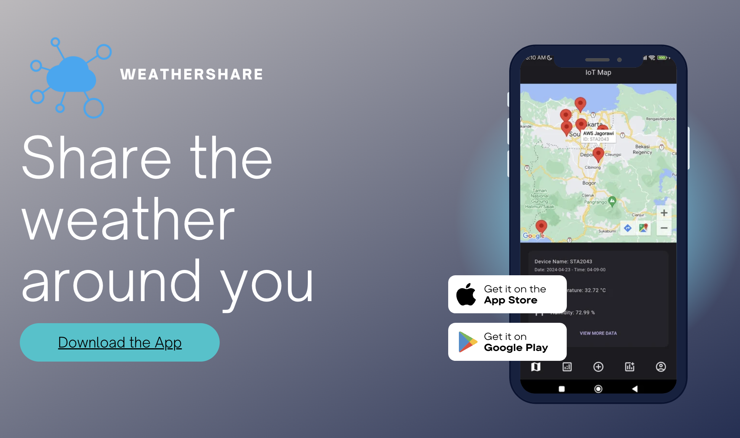

Slide 22
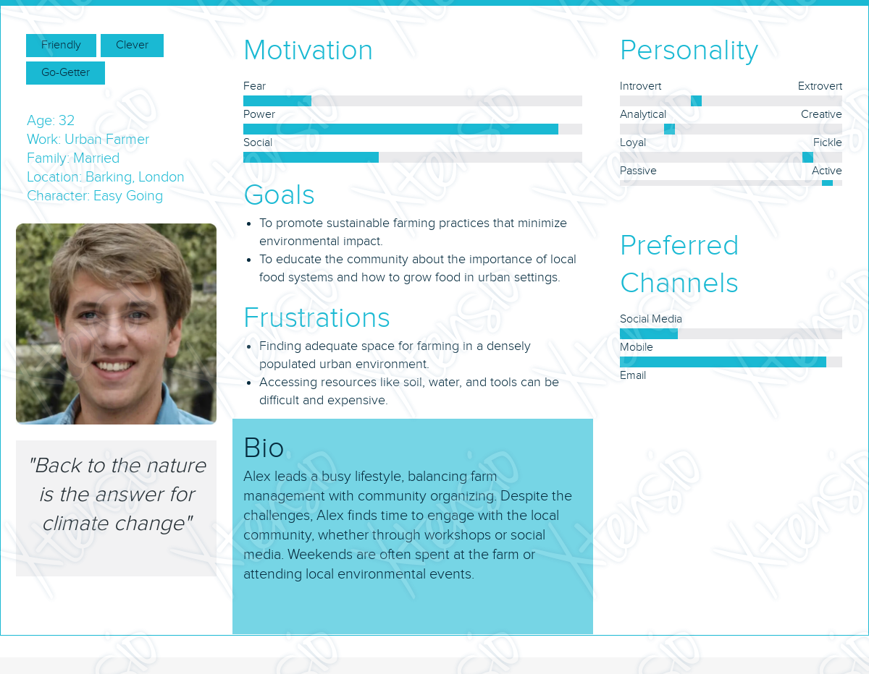
User Personas

